Slide 1

BATCH – 09 (SEC – 19) FIELD PROJECT
BATCHMATES:
M. Shiva kumar ( 241FA04284)
P . Nikhil sai (241FA04289)
Sk . Ajmal (241FA04332)
T . Hari krishna (241FA04348)

Slide 2
Field project ELECTRICAL AUTO MOBILES DEFECT SENSORS

Slide 3
INTRODUCTION TO ELECTRICAL AUTO MOBILES DEFECT SENSORS:-
Electrical Automobiles (Electric Vehicles – EVs) are vehicles that run using electric motors powered by batteries instead of petrol or diesel engines. Since EVs depend heavily on electrical systems, sensors play a major role in detecting defects and ensuring safety, efficiency, and smooth performance.
Defect detection sensors help in identifying faults such as battery overheating, motor malfunction, brake failure, short circuits, and system errors.

Slide 4
Objectives of the Project-
To study different sensors used in electrical automobiles
To understand how defect detection works
To analyze common electrical faults in EV
To study safety mechanisms in EV system

Slide 5
Components of an Electrical Automobile:-
Battery Pack
Electric Motor
Controller (ECU – Electronic Control Unit)
Inverter
Charging Port
Sensors (Temperature, Current, Voltage, etc.

Slide 6
Types of Defect Detection Sensors in EVs:-
1. Temperature Sensors:-
Monitor battery and motor temperature
Prevent overheating
Activate cooling system if temperature rises
2. Current Sensors:-
Measure the current flow in circuits
Detect short circuits or overload conditions
Protect battery and motor from damage

Slide 7
3. Voltage Sensors:-
Monitor battery voltage levels
Detect overcharging and deep discharge
Ensure stable power supply
4. Speed Sensors:-
Measure wheel and motor speed
Detect abnormal speed conditions
Help in regenerative braking

Slide 8
Working Principle of Defect Detection:-
Sensor continuously monitors system parameter
Data is sent to ECU (Electronic Control Unit
ECU compares data with safe limits
Common Defects in Electrical Automobiles:-
Battery overheating
Overcharging
Motor winding failure
Short circuit

Slide 9
Field Study (Example Observation):-
Most common defect: Battery overheating
Cause: Poor ventilation and overcharging
Solution: Improved cooling system and BMS upgrade
Advantages of Using Defect Sensors:-
Increases safety
Prevents major damage
Improves vehicle lifespan
Reduces maintenance cost

Slide 10
Conclusion:-
Defect detection sensors are very important in electrical automobiles. They ensure safety, improve performance, and prevent serious damage.
With advancements in AI and smart technology, future EVs will have more accurate and intelligent fault detection systems.

Slide 11
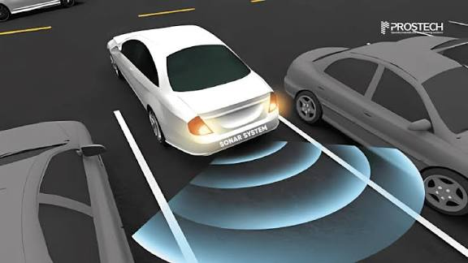
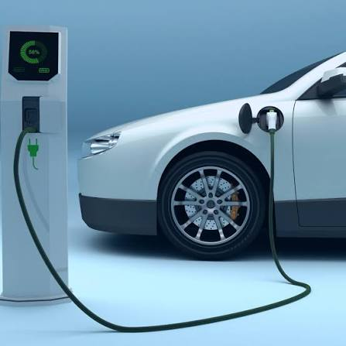
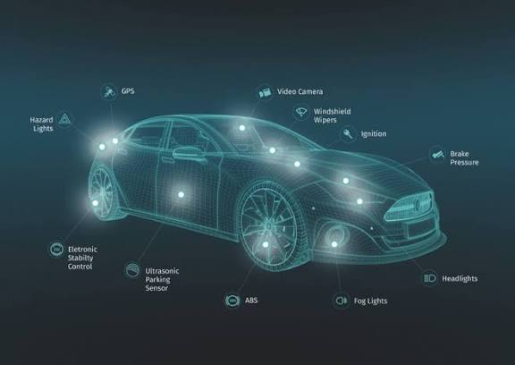

Slide 12
<!DOCTYPE html>
<html>
<head>
<title>EV Defect Sensor Monitoring System</title>
<style>
body {
font-family: Arial, sans-serif;
background: #eef2f3;
text-align: center;
padding: 30px;
} .container {
background: white;
padding: 25px;
border-radius: 12px;
width: 500px;
margin: auto;
box-shadow: 0 0 15px gray;
}
h2 {

Slide 13
color: #2c3e50;
} .sensor {
margin: 8px 0; }
.warning {
color: red;
font-weight: bold;
}
.safe {
color: green;
font-weight: bold;
}
button {
padding: 10px 20px;
margin-top: 15px;
cursor: pointer;
background: #3498db;
color: white;
border: none;
border-radius: 5px;
}
button:hover {
background: #2980b9;
}
</style>
</head>
<body>

Slide 14
<div class="container">
<h2>Electric Vehicle Defect Sensor Dashboard</h2>
<div class="sensor">Temperature: <span id="temp">0</span> °C</div>
<div class="sensor">Battery Voltage: <span id="voltage">0</span> V</div>
<div class="sensor">Motor Current: <span id="current">0</span> A</div>
<div class="sensor">Vehicle Speed: <span id="speed">0</span> km/h</div>
<div class="sensor">Brake Status: <span id="brake">Normal</span></div>
<div class="sensor">Insulation Leakage: <span id="leakage">0</span> mA</div>
<h3 id="status" class="safe">System Safe</h3>
<button onclick="checkSensors()">Check All Sensors</button>
</div>
<script>function checkSensors() {

Slide 15
// Simulated sensor values
let temperature = Math.floor(Math.random() * 100);
let voltage = Math.floor(Math.random() * 60);
let current = Math.floor(Math.random() * 50);
let speed = Math.floor(Math.random() * 120);
let brakeFault = Math.random() < 0.2;
// 20% chance brake fault
let leakage = Math.floor(Math.random() * 20);
// Display values
document.getElementById("temp").innerText = temperature; document.getElementById("voltage").innerText = voltage; document.getElementById("current").innerText = current; document.getElementById("speed").innerText = speed; document.getElementById("brake").innerText = brakeFault ? "Brake Fault!" : "Normal"; document.getElementById("leakage").innerText = leakage;
let status = document.getElementById("status");

Slide 16
// Fault Conditions
if (temperature > 60) {
status.innerText = "Warning: Motor Overheating!";
status.className = "warning";
} else if (voltage < 40) {
status.innerText = "Warning: Low Battery Voltage!";
status.className = "warning";
} else if (current > 35) {
status.innerText = "Warning: Over Current Detected!";
status.className = "warning";
}
else if (brakeFault) {
status.innerText = "Warning: Brake System Fault!";
status.className = "warning";
} else if (leakage > 10) {
status.innerText = "Warning: Insulation Leakage Detected!";
status.className = "warning";
} else {
status.innerText = "System Safe";
status.className = "safe";
}
}
</script>
</body>
</html>

Slide 17
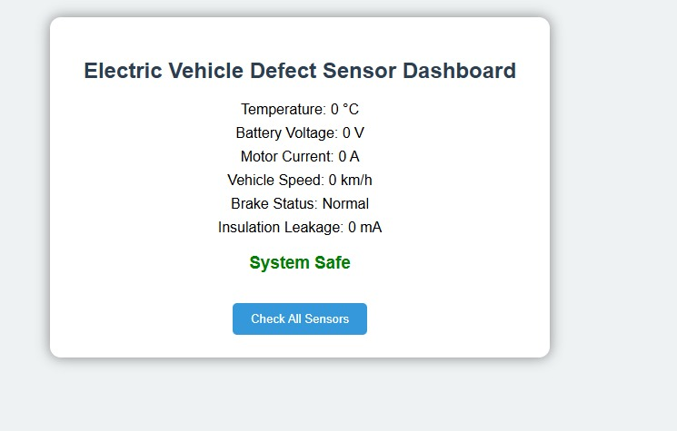
System safe

Slide 18
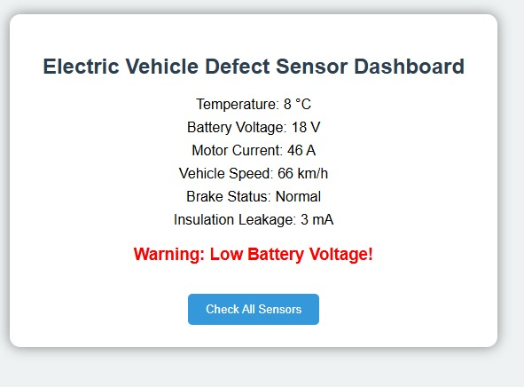

Slide 19
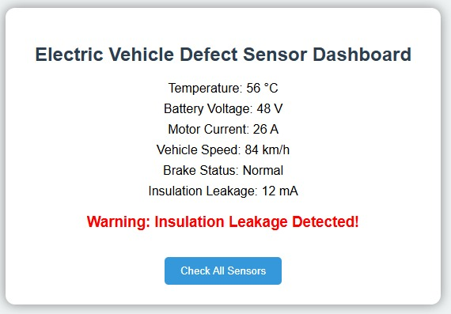

Slide 20
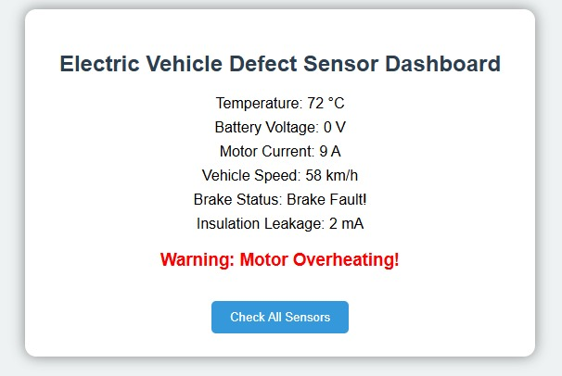

Slide 21
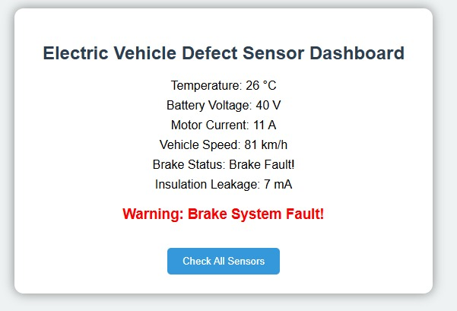

Slide 22
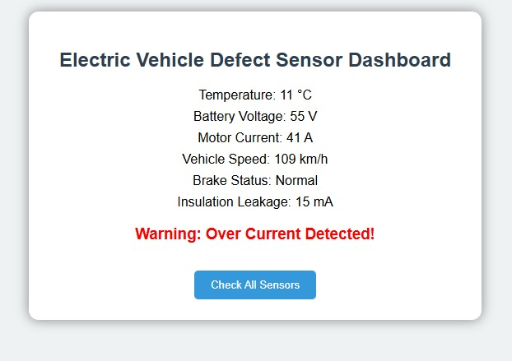

Slide 23
Methodology
Electric vehicle (EV) defect sensor methodology focuses on identifying failures in critical components like batteries, motors, and power electronics using techniques ranging from mathematical modeling to artificial intelligence. These methods generally aim to detect sensor faults, such as bias, drift, or complete signal loss, ensuring the safety and reliability of the vehicle

Slide 24
Thank you

